Slide 1
DAILY PLANNER WHAT IS IT?
WHY EVEN DO IT?

Slide 2
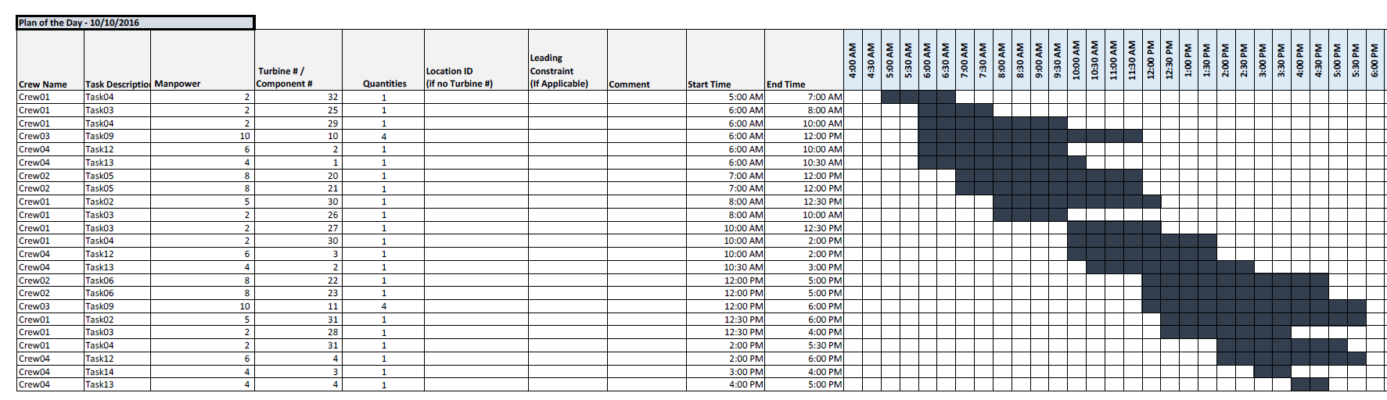
DAILY PLANNER: HAVING A DAILY MASTER PLAN
GOAL: PLAN A DAY WITH A MASTER PLAN

Slide 3
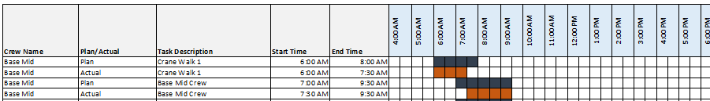
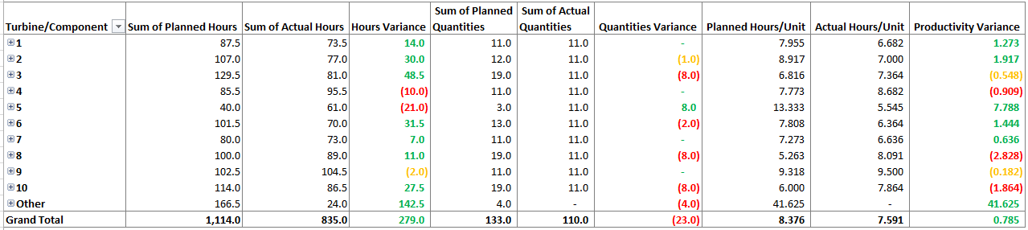
DAILY PLANNER: GETTING METRICS AND VISUAL DISPLAYS

Slide 4
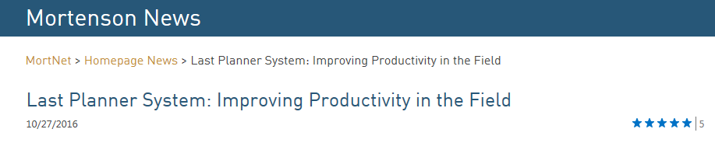
DAILY PLANNER: SHIFTING OUR MINDSET
WE WANT TO SHIFT OUR MINDSET FROM PRODUCTIVITY TO SCHEDULE OPTIMIZATION, AND AS A RESULT, PRODUCTIVITY SHOULD FOLLOW.
IT’S PROVEN THAT IT WORKS. DIFFERENT STUDIES PROVE ITS SUCCESS.
WE’VE DONE SOMETHING SIMILAR ON ANOTHER MORTENSON PROJECT.
Trialed this in Grand Prairie; We saw a good correlation between utilization of the tool and increased project productivity.

Slide 5
DAILY PLANNER: LOGIC BEHIND WHY IT WORKS
1. PLANNING IMPROVES PRODUCTIVITY
2. MEASURING PLANNING PROVIDES INSIGHT
3. INSIGHT LEADS TO BETTER PLANNING

